Slide 1
UT Robomasters – Supercap Power Stage Modeling
Supercap Technical Lead: Egan Wang (ew23776)
Contributing Members: Timothy Yeap, Ethan Chu, Heath Luebsen

Slide 2
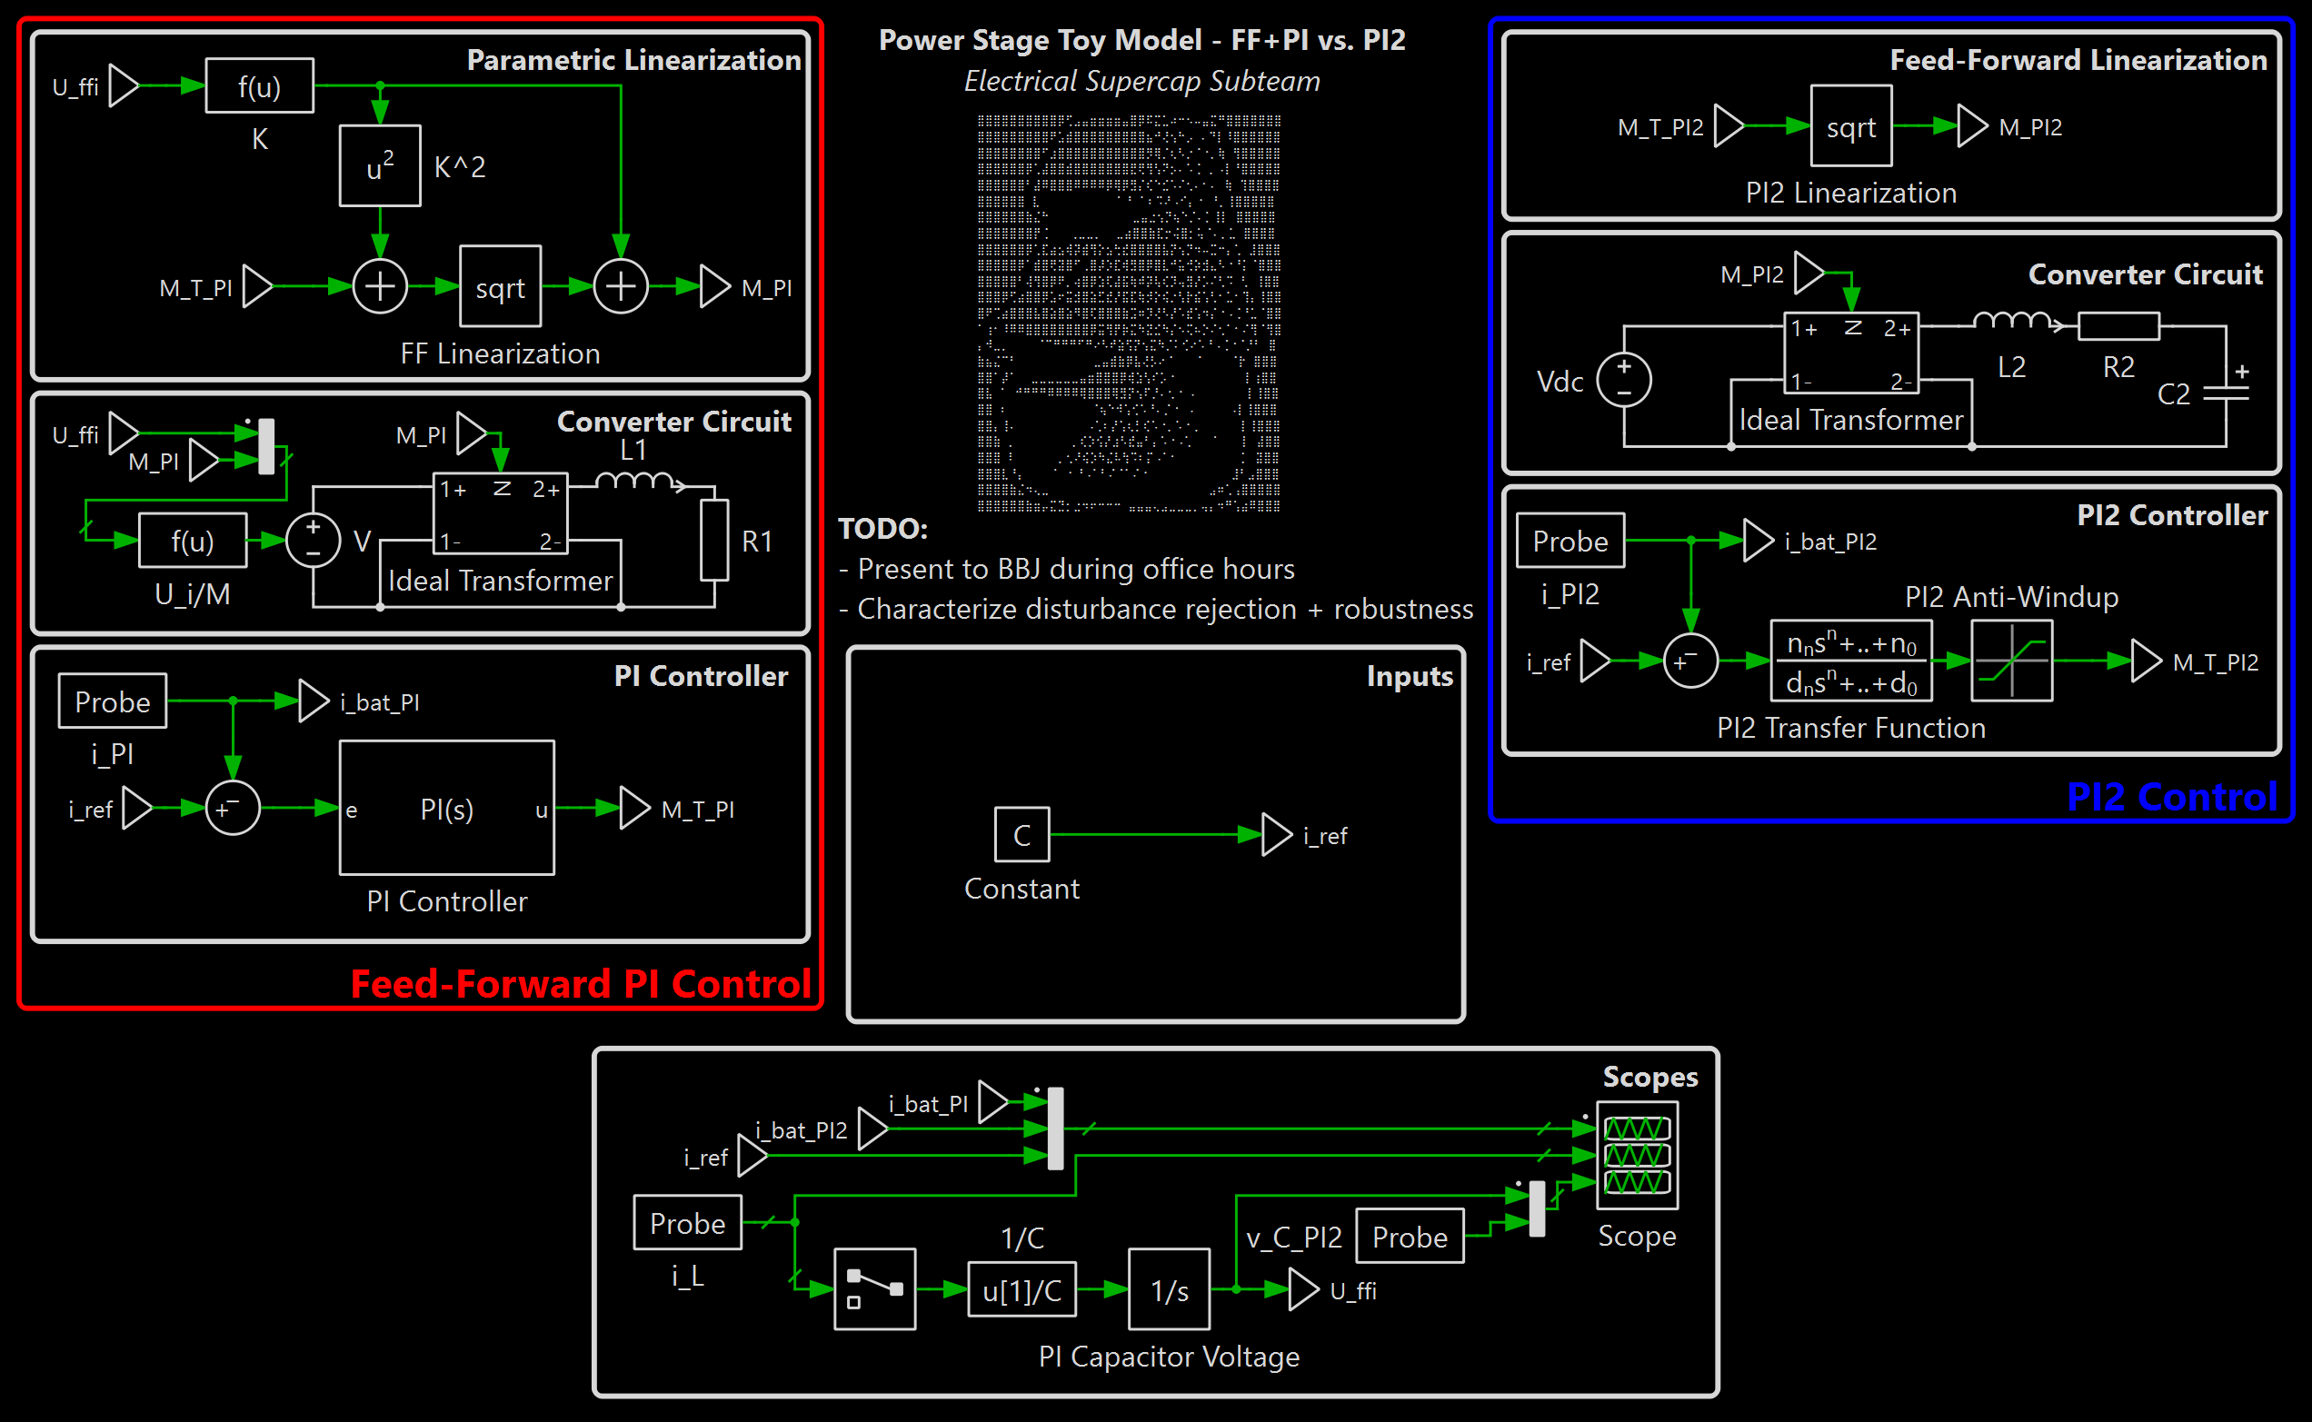
PLECS Analysis: Toy Models
Toy Model Simulation as of Making These Slides
In GitHub repository, under Sims_and_Design folder
Message me (Egan) if you don’t understand a section of this model
Power Stage Simulation - Toy Model.plecs
In case you didn’t know yet, this is what everything is about

Slide 3
List of Topics Relevant to This Presentation
Make sure you have at least basic knowledge of these concepts so that you can understand the content in this presentation:
SRA calculations
Ideal transformer modeling
Laplace transforms
Transfer functions and closed-loop systems
Make sure you are very familiar with these concepts:
KVL and KCL
Algebraic manipulation
Differential and integral calculus

Slide 4
Section 1: Basics of The Converter
take notes if you have to

Slide 5
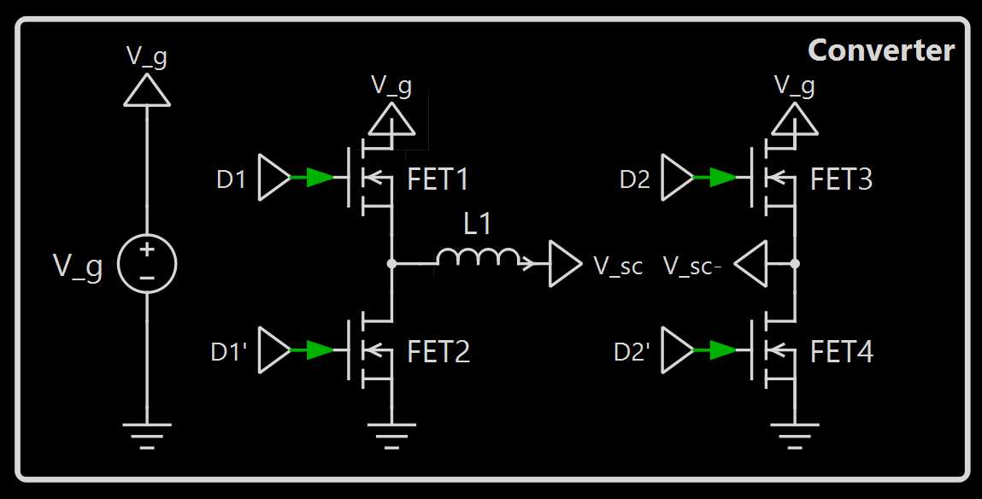
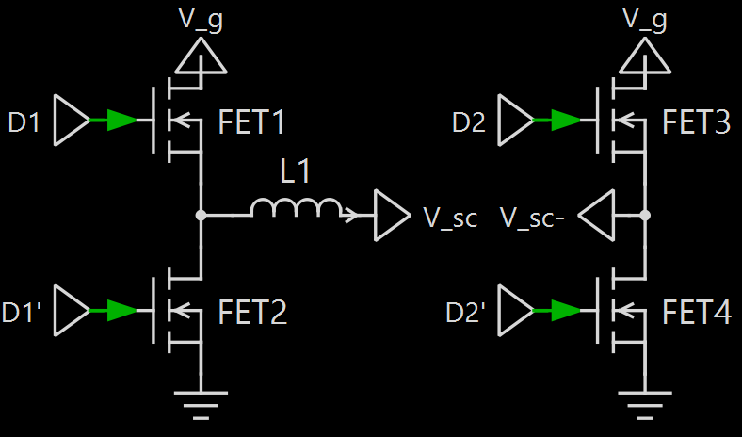
Overview of Topology
H-Bridge Converter
4 switches
2 half-bridges
Full-bridge analogue to buck converter
Voltage across switched nodes can be +Vg, 0, or +Vg
Possible Voltages
1 high, 2 low
1 high, 2 high
+
-
+
-
+V_{g}
0
1 low, 2 low
1 low, 2 high
+
-
+
-
0
-V_{g}

Slide 6
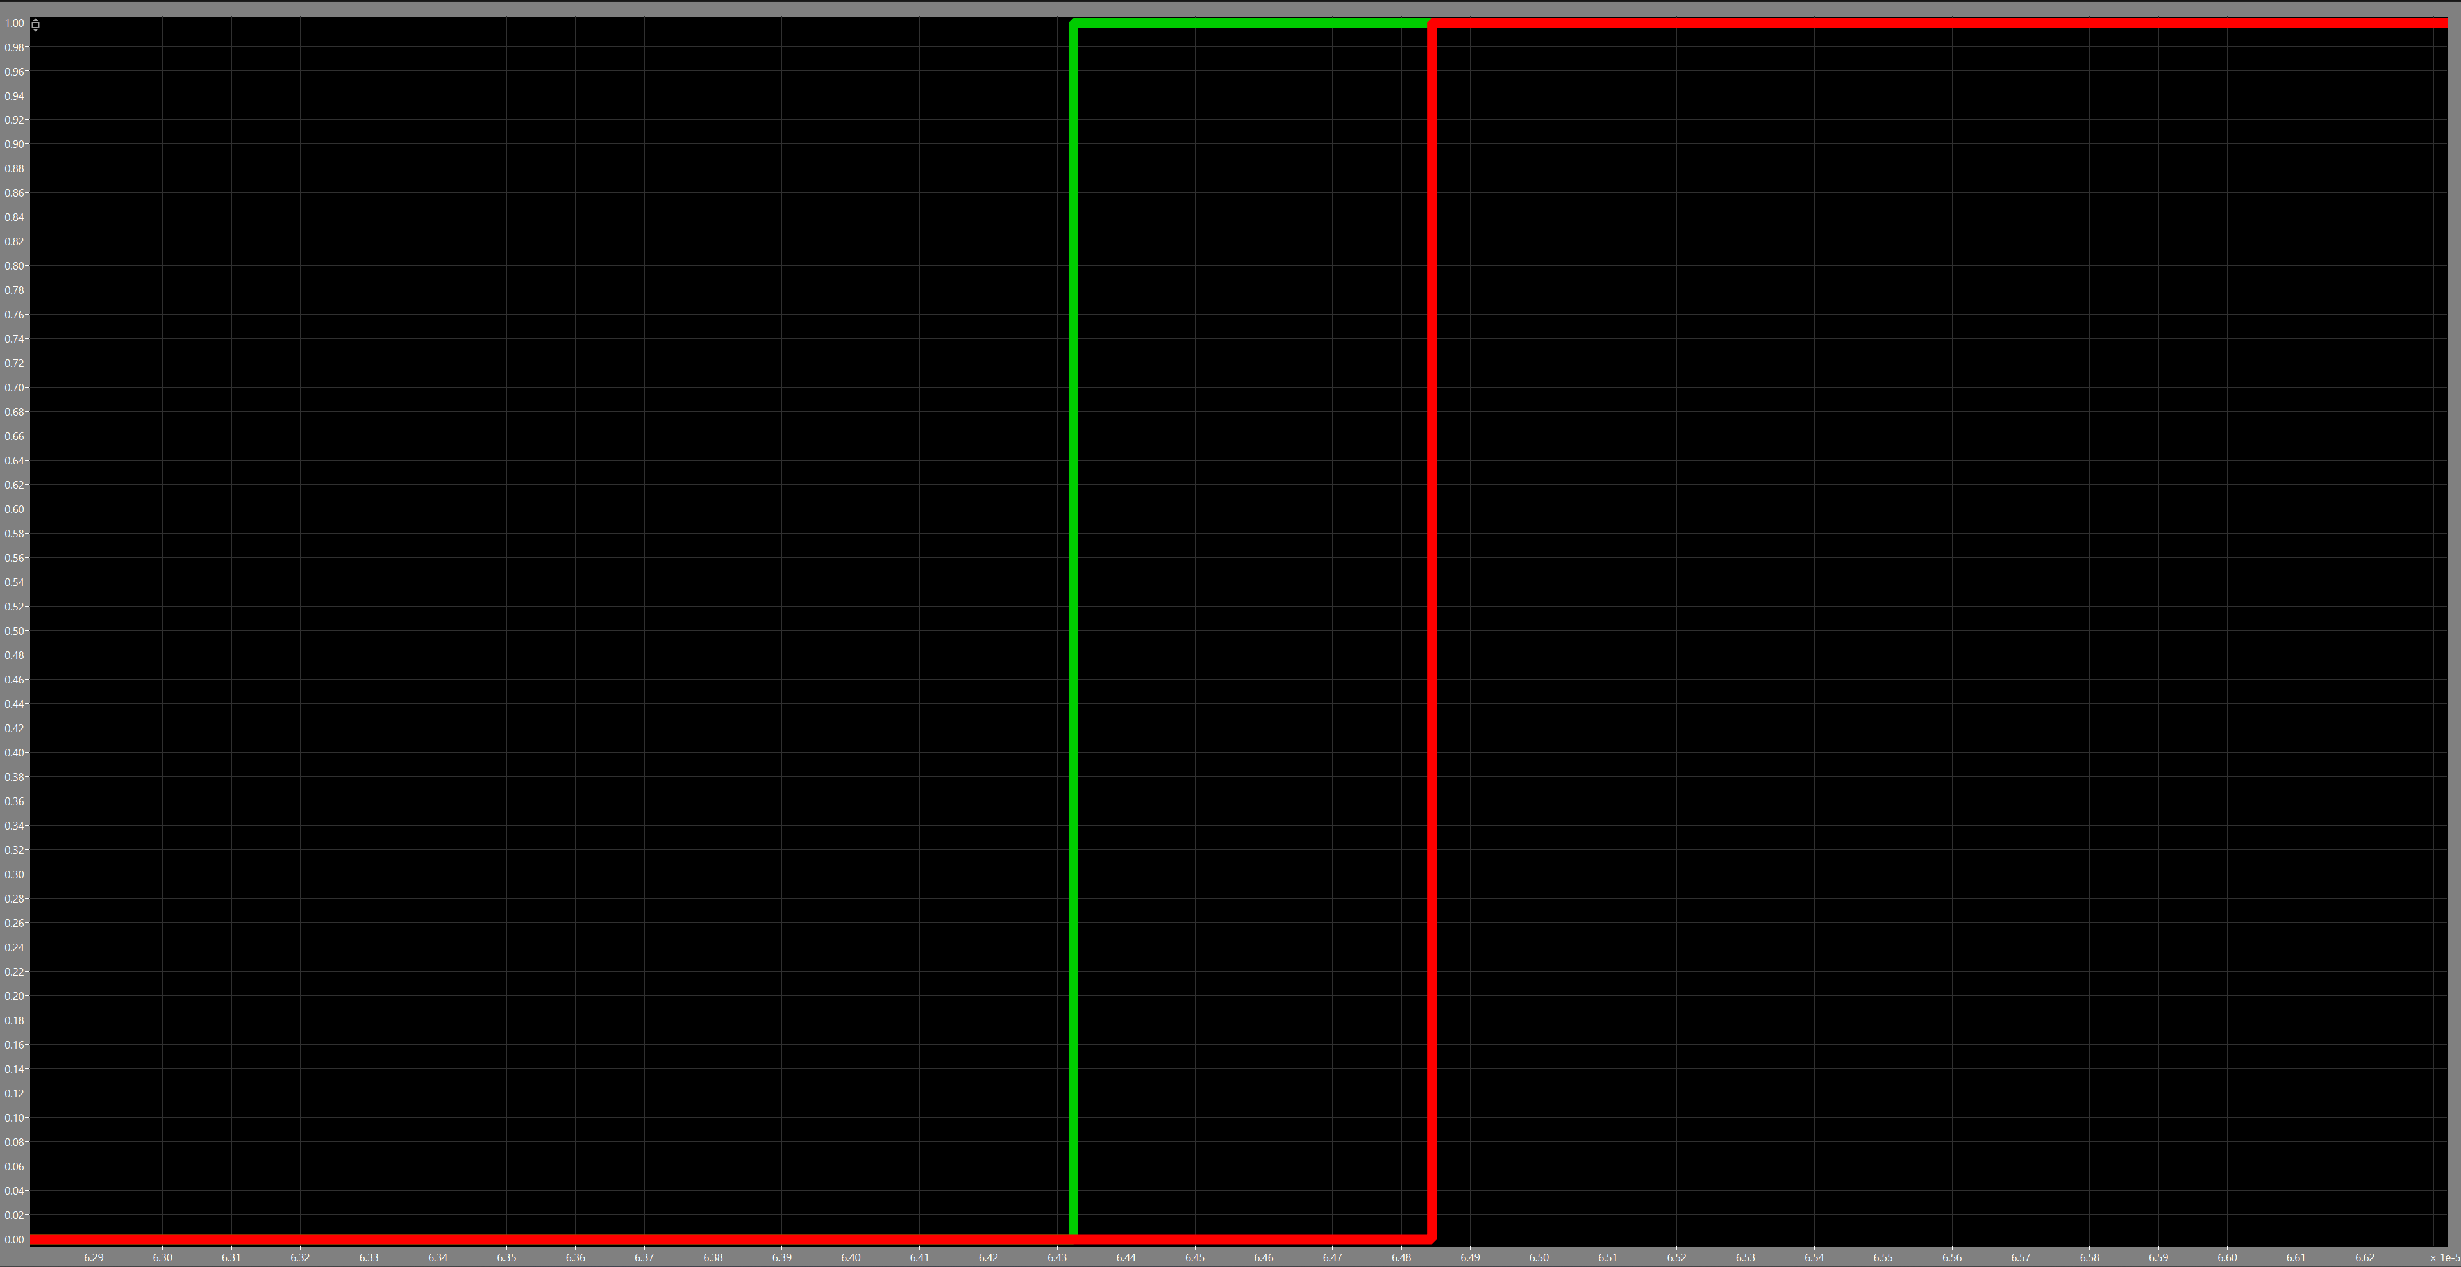
Duty Cycle Control
Scope Reading
Half-bridge 1
Half-bridge 2
d_{off}(t)
d_{off}(t)
Half-bridges 1 and 2 are independent
Both high and both low result in 0 voltage across switch nodes
Duty ratios <2.5% and >97.5% are risky because MOSFETs take time to turn on and off
H-bridge topology allows finer control
Control scheme shown on right
Duty cycle “seen” across switch nodes labelled as M(t)
Halfway point (50% duty cycle)
Half-bridge 1 duty ratio: 0.5 + d_{off}(t)
Half-bridge 2 duty ratio: 0.5 – d_{off}(t)
Duty cycle “seen” by inductive tank: 2*d_{off}(t)

Slide 7
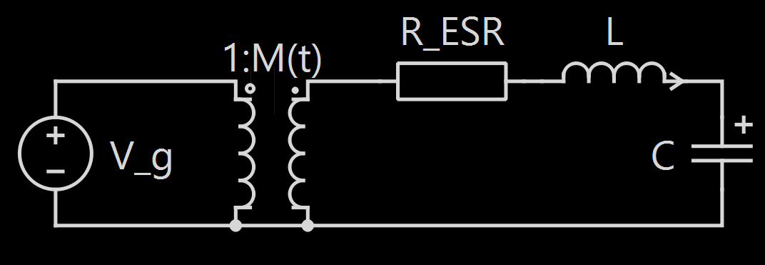
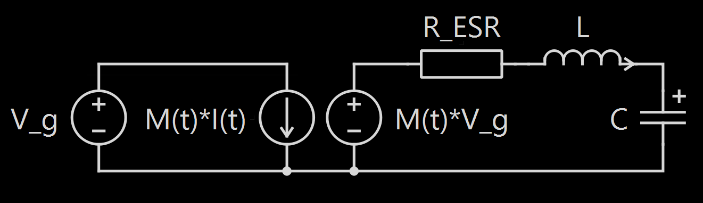
Transformer Equivalent
Ideal Transformer Model
Use SRA analysis and derive KCL- and KVL-like equations
Convert into loops and create ideal transformer model of circuit with gain 1:M(t)
Transformer model will be useful for reflection math tricks
Voltage/Current Source Model
read it if you don’t know what transformer reflection is

Slide 8
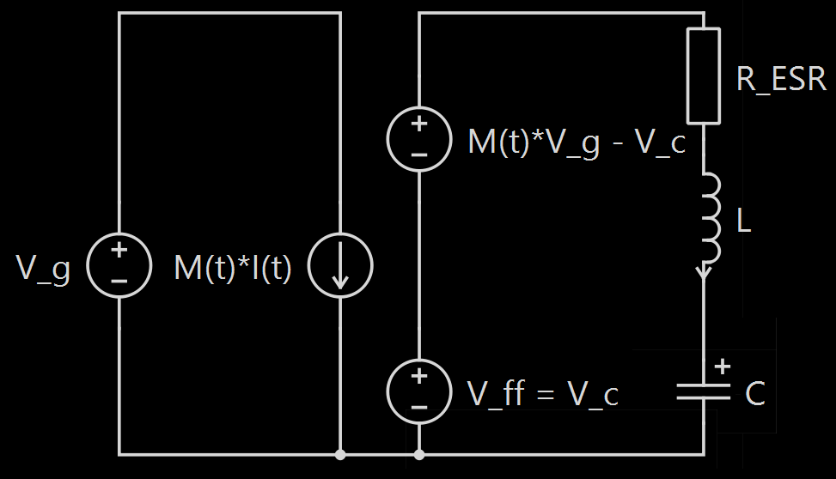
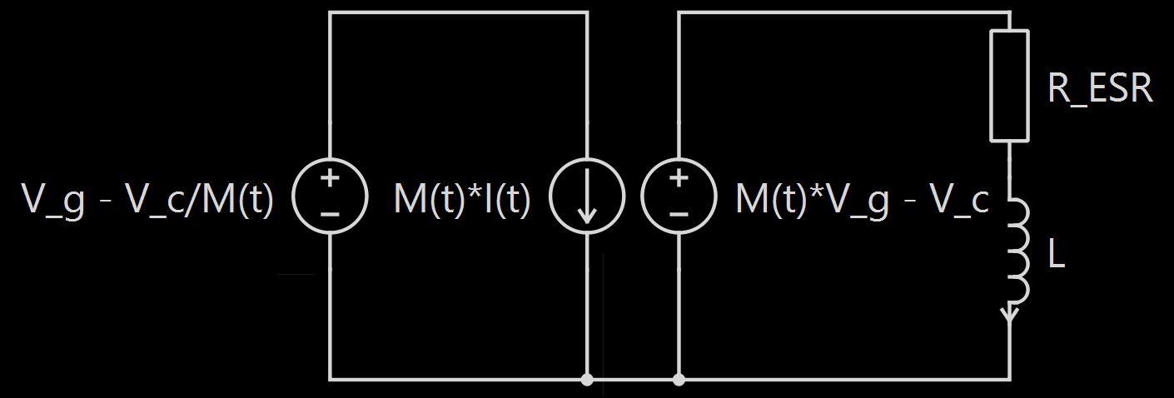
Capacitor Feed-Forward Correction
Separated Voltages
Split the voltage source on the right into a V_{c}(t) component and remainder
Remainder voltage has to be equal to voltage across RL branch
Current is conserved - take note of the current/voltage behavior of the transformer
“Cut out” the capacitor and focus on the RL branch
Even though V_{c}(t) is time-variant, it changes very slowly and can be treated as constant
Remember to adjust the voltage source on the left side to compensate – reflect the new voltage source by dividing by M(t)
Isolated RL Branch

Slide 9
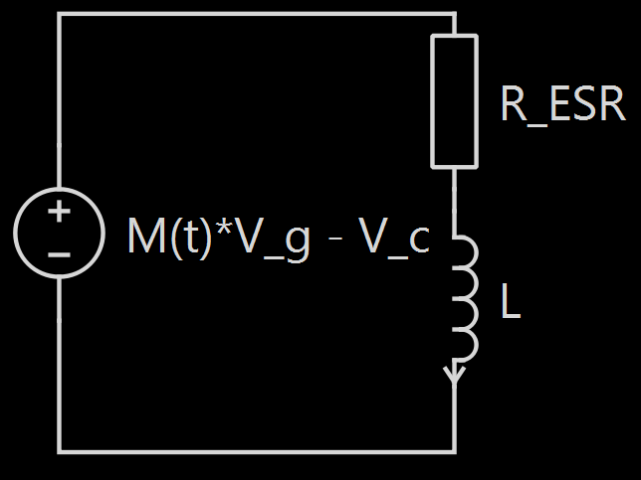


Battery Current Reflection
Complete Toy Model
Reflect the voltage source across the transformer
In previous diagram, this is basically already done
Battery current needs to be scaled by turns ratio
We have our toy model!
Write the KVL equation*:
$$M\left(t\right)∗V_{g}−V_{c}=\frac{R_{ESR}}{M\left(t\right)}∗I_{bat}\left(t\right)+\frac{L}{M\left(t\right)}∗\frac{d}{dt}I_{bat}(t)$$
*before you ask, yes, this calculation ignores the $\frac{dM(t)}{dt}$ term that appears when doing the product rule for $\frac{d}{dt}I_{RL}(t)$. It is possible to account for this by doing another pair of transformer voltage/current reflections, but this presentation is long enough, and we find out that the term is negligible anyway. Consider this an exercise for the reader to prove, if you will.
I_{RL}(t) = I_{bat}(t)/M(t)

Slide 10


Algebraic Manipulation & Linearization
From the equation:
$$M\left(t\right)∗V_{g}−V_{c}=\frac{R_{ESR}}{M\left(t\right)}∗I_{bat}\left(t\right)+\frac{L}{M\left(t\right)}∗\frac{d}{dt}I_{bat}(t)$$
Multiply by M(t):
$$M{\left(t\right)}^{2}∗V_{g}−M\left(t\right)∗V_{c}=R_{ESR}∗I_{bat}\left(t\right)+L∗\frac{d}{dt}I_{bat}(t)$$
This is quite the nasty equation. It has quadratic terms and a derivative. Let’s define a new variable for the LHS of the equation,
$$M_{T}\left(t\right)=M{\left(t\right)}^{2}−M\left(t\right)∗\frac{V_{c}}{V_{g}}$$
labelled M_{T}(t) due to being roughly equivalent to the “transformer reflection” of the voltage gain M(t).
We complete the square and rewrite:
$$M_{T}\left(t\right)={\left(M\left(t\right)−\frac{V_{c}}{2V_{g}}\right)}^{2}−{\left(\frac{V_{c}}{2V_{g}}\right)}^{2}$$
We can then define an auxiliary variable:
$$M_{T}\left(t\right)={\left(M\left(t\right)−K_{T}\right)}^{2}−K_{T}^{2},K_{T}=\frac{V_{c}}{2V_{g}}$$
Rewrite the KVL equation:
$$V_{g}∗M_{T}(t)=R_{ESR}∗I_{bat}\left(t\right)+L∗\frac{d}{dt}I_{bat}(t)$$
By encapsulating the quadratic term within a new variable, we now have only additions, scalar multiplications, and derivatives – the equation is linear! We can now convert to s-domain:
$$V_{g}∗M_{T}\left(s\right)=R_{ESR}∗I_{bat}\left(s\right)+sL∗I_{bat}(s)$$
Rewrite as a transfer function:
$$G_{I_{bat},M_{T}}\left(s\right)=\frac{V_{g}}{sL+R}$$
We have a proper transfer function now!

Slide 11
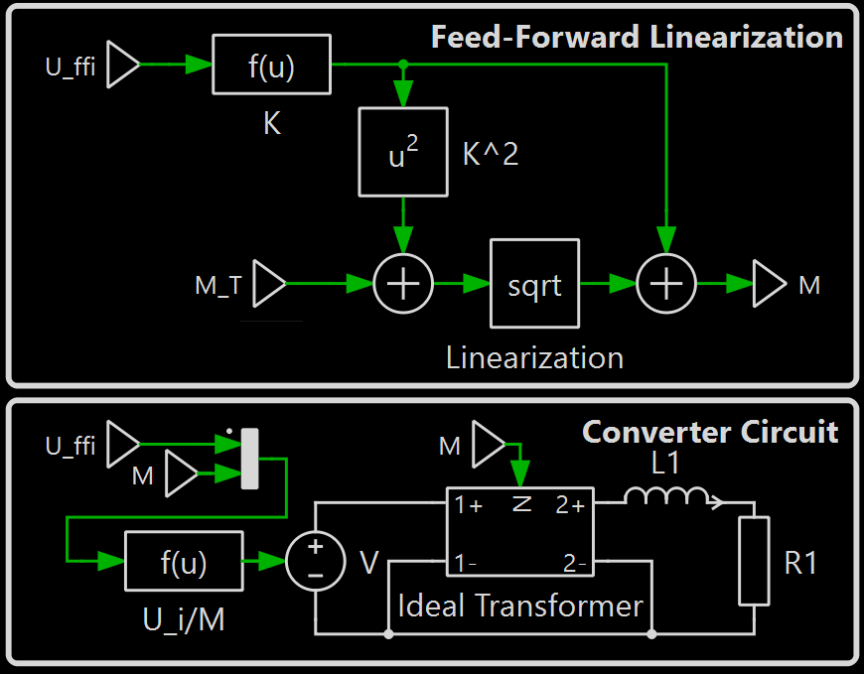



Overall System Design – FF+PI
$$u(t)⇔M_{T}(s)$$
We go back to our definition of M_{T}(t):
$$M_{T}\left(t\right)={\left(M\left(t\right)−K_{T}\right)}^{2}−K_{T}^{2},K_{T}=\frac{V_{c}}{2V_{g}}$$
Solve for M(t):
$$M\left(t\right)=K_{T}±\sqrt{M_{T}\left(t\right)+K_{T}^{2}}$$
We will be using the solution with both terms added. (The subtractive solution produces identical behavior. Proof is left as exercise to the reader.)
We can thus design our system as a linear black box composed of the linearization above combined with the physical circuitry.
Linearization + Circuit
$$I_{bat}\left(s\right)$$
$$=G_{I_{bat},M_{T}}\left(s\right)∗M_{T}(s)$$
$$=\frac{V_{g}}{sL+R}M_{T}(s)$$

Slide 12
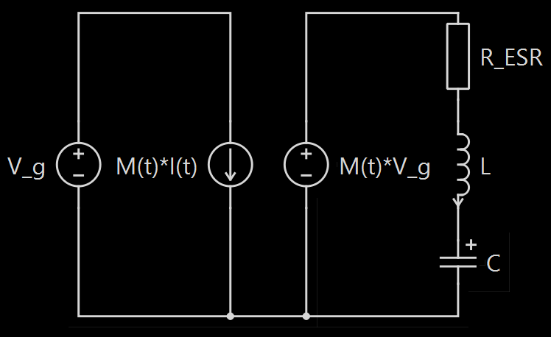
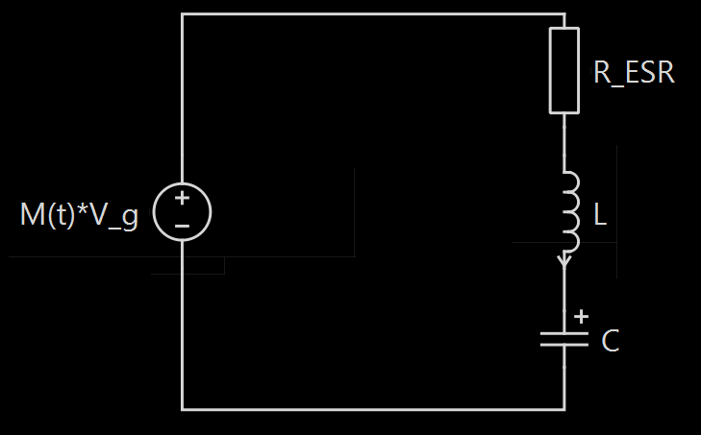


Alternative Design – PI² Control
Singular RLC Branch
Math trick of defining auxiliary variable can be done earlier
No need to split apart voltage source on right side of transformer
Reflect battery current to right side once again
New toy model appears analogous to the one in the FF+PI model
Write new KVL loop equation*:
$$M\left(t\right)∗V_{g}=\frac{R_{ESR}}{M\left(t\right)}∗I_{bat}\left(t\right)+\frac{L}{M\left(t\right)}∗\frac{d}{dt}I_{bat}\left(t\right)+\frac{1}{C∗M(t)}\int{I_{bat}\left(t\right)dt}$$
*Remember that caveat in small print from before? Exercise for the reader: can we ignore this imperfection in our calculus now?
Complete Toy Model
I_{RL}(t) = I_{bat}(t)/M(t)

Slide 13


PI² Control Linearization
From the equation:
$$M\left(t\right)∗V_{g}=\frac{R_{ESR}}{M\left(t\right)}∗I_{bat}\left(t\right)+\frac{L}{M\left(t\right)}∗\frac{d}{dt}I_{bat}\left(t\right)+\frac{1}{C∗M(t)}\int{I_{bat}\left(t\right)dt}$$
Multiply by M(t):
$$M{\left(t\right)}^{2}∗V_{g}=R_{ESR}∗I_{bat}\left(t\right)+L∗\frac{d}{dt}I_{bat}\left(t\right)+\frac{1}{C}\int{I_{bat}\left(t\right)dt}$$
Our algebra trick is a lot simpler now, and we don’t need to complete the square or define a new auxiliary variable:
$$M_{T}\left(t\right)=M{\left(t\right)}^{2}, M\left(t\right)= ±\sqrt{M_{T}\left(t\right)}$$
Our KVL equation is now:
$$V_{g}∗M_{T}(t)=R_{ESR}∗I_{bat}\left(t\right)+L∗\frac{d}{dt}I_{bat}(t)+\frac{1}{C}\int{I_{bat}\left(t\right)dt}$$
Converting to s-domain:
$$V_{g}∗M_{T}\left(s\right)=R_{ESR}∗I_{bat}\left(s\right)+sL∗I_{bat}\left(s\right)+\frac{1}{sC}∗I_{bat}\left(s\right)$$
Rewrite as a transfer function:
$$G_{I_{bat},M_{T}}\left(s\right)=\frac{sV_{g}C}{s^{2}LC+sRC+1}$$
A little messier, but this is once again a proper transfer function. Note the factor of s in the numerator.
Once again, we can combine the M_{T}(t) to M(t) transformation and the electrical circuitry together and treat it as a singular linear system.
While I was able to skip over many steps since the approach is similar, this idea of PI² control seems to be significantly simpler, even if the transfer function looks more complicated. So why not use this method? Let’s test them out…

Slide 14
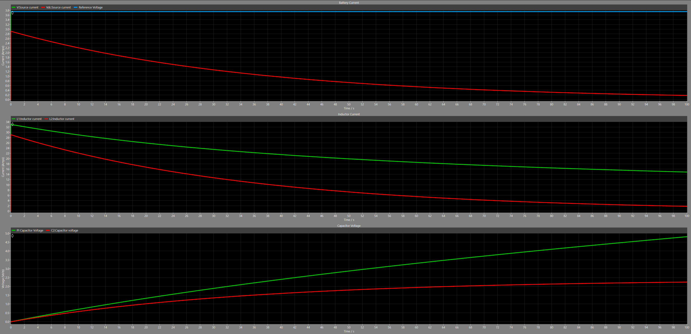
Time-Domain Simulation (0s<t<100s)
Response to 3.75A step input
FF+PI performance is in green
PI² performance is in red
You can’t see it here, but the FF+PI current waveform is overlapping the target current
Constant Target Current

Slide 15

Time-Domain Analysis
Remember that asterisk? What we did was assume that
$$\frac{1}{C}\int{\frac{I_{bat}(t)}{M(t)}dt}=\frac{1}{C∗M(t)}\int{I_{bat}(t)}dt$$
We can’t actually do this since M(t) is not a scalar value, and this has come back to bite us. Notice that this integral term corresponds precisely to the voltage term that was accounted for with a feed-forward signal!
Therefore, going forward, our best bet is to stick with FF+PI control.
Note: If y’all can figure out a way to get a more accurate representation of the system and get a feasible implementation of PI² control, please let me know

Slide 16
Addendum: On Feed-Forward Systems
In general, feed-forward systems are a way to perform disturbance rejection, where extraneous signals that result from interactions of the system with itself and surroundings (known as disturbances) have their undesirable effects minimized. This particular approach directly measures the quantity in question (capacitor voltage) and subtracts it – pretty intuitive.
A question I answered and found pertinent to include: Why not feed-forward the inductor current? The inductor current is the “through” variable for the entire RLC branch, so performing feed-forward cancellation would result in a controlled current of 0.

Slide 17
Section 2: Reverse Charging and Boost Mode
PLECs moment

Slide 18
Overall System Review: Reverse Charging
Basic Full System Model
Battery
Load
Whole system works as parallel sources
Nodes between battery, converter, and load use KCL to divide current
No qualitative distinction between forward charging (storing excess energy) and reverse charging (releasing needed energy)
System must work seamlessly between both forward and reverse to allow current control behavior
Converter

Slide 19

Reverse Charging: Maximum Reverse Current
Isolated RL Branch
Formula for $M\left(t\right)$ has limits:
$$M\left(t\right)=K_{T}±\sqrt{M_{T}\left(t\right)+K_{T}^{2}}$$
$M_{T}\left(t\right)<−K_{T}^{2}$ results in non-real $M\left(t\right)$
Sets limit on maximum reverse current using $M_{T}\left(t\right)$math trick
Minimum $M_{T}\left(t\right)$corresponds to $M\left(t\right)=K_{T}$, greater than minimum $M\left(t\right)$ realizable
Look back on model with RL branch – possible to attain higher reverse current?
$I_{bat}\left(t\right)=I_{L}\left(t\right)∗M(t)<0$ requires either $I_{L}\left(t\right)<0, M\left(t\right)>0$ or $I_{L}\left(t\right)>0, M\left(t\right)<0$
Negative current means current flows into battery
Either current flows in reverse from inductor or transformer polarity flips

Slide 20




Maximum Reverse Current, Continued
$I_{L}\left(t\right)>0, M\left(t\right)<0$
$$I_{L}\left(t\right)<0, M\left(t\right)>0$$
Possible Voltages
Isolated RL Branch
1 high, 2 low
1 high, 2 high
+
-
+
-
+V_{g}
0
1 low, 2 low
1 low, 2 high
+
-
+
-
0
-V_{g}
$I_{L}(t)<0$ corresponds to negative inductor current
Steady-state negative inductor current requires $M\left(t\right)∗V_{g}−V_{c}<0$ due to RL branch impedance
Thus $M\left(t\right)∗V_{g}<V_{c}, M\left(t\right)>0$, $I_{bat}\left(t\right)<0$
Reverse charging is possible!
$M\left(t\right)<0$ corresponds to a change to $−V_{g}$ regime
Current flowing out of capacitor results in negative inductor current
Thus $I_{L}\left(t\right)<0, M\left(t\right)<0$, $I_{bat}\left(t\right)>0$
Reverse charging not possible!

Slide 21


Maximum Reverse Current, Continued
To find steady-state maximum reverse current, we approximate the inductor as having 0 impedance. Negative voltage across resistor in RL branch causes negative current which is then reflected across ideal transformer. We can thus derive an expression for reverse current:
$$I_{bat}\left(t\right)=\frac{V_{G}∗M{\left(t\right)}^{2}−V_{C}∗M(t)}{R}$$
Apply optimization for maximum reverse current:
$$I_{bat,max}=\frac{V_{C}^{2}}{4V_{G}R},M\left(t\right)=\frac{V_{C}}{2V_{G}}=K$$
A familiar constant appears! Let’s see if a corresponding $M_{T}(t)$ appears:
$$M_{T}\left(t\right)={\left(M\left(t\right)−K_{T}\right)}^{2}−K_{T}^{2}$$
$$∴M_{T}\left(t\right)=−K_{T}^{2}$$
This is precisely the minimum value we saw earlier!
This conclusion tells us that our control scheme should (at least theoretically) work in with both forward and reverse currents. All we need to do is make sure that $M_{T}\left(t\right)$ never drops below its minimum value of $−K_{T}^{2}$, and we should be able to see a smooth transition between the two domains!
To find out, we simply leave everything as-is and see what happens when we set the reference current to a negative value.

Slide 22
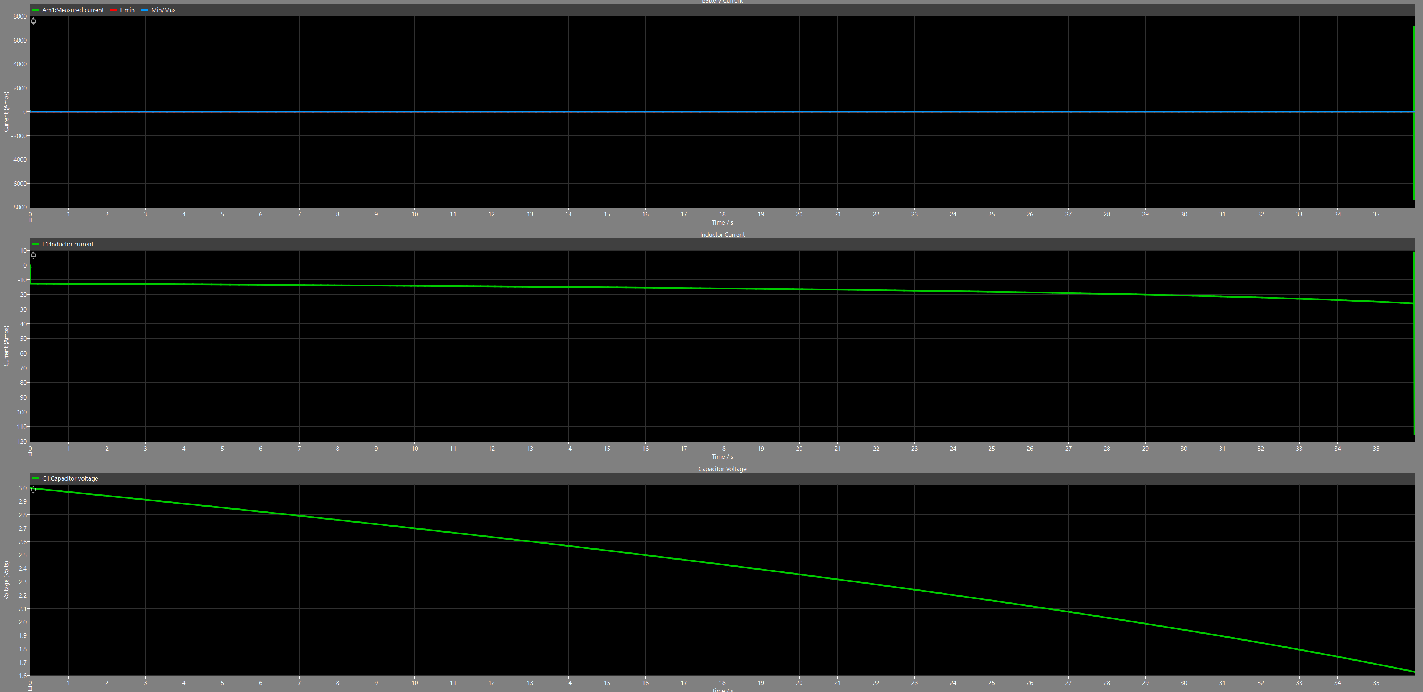
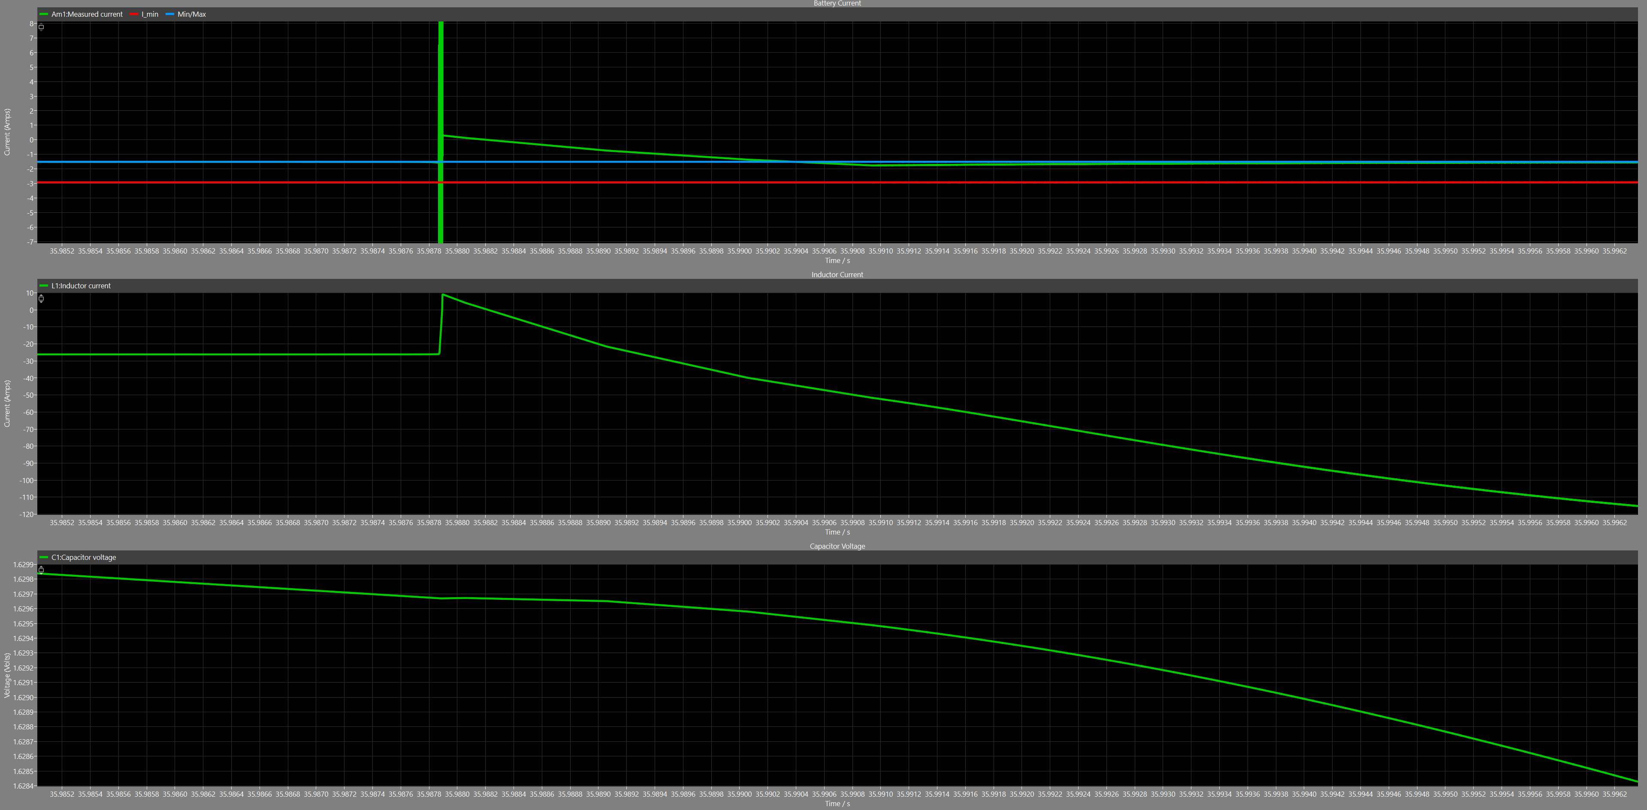
Time-Domain Simulation (0s<t<????)

Slide 23
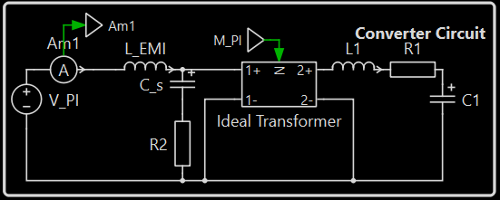
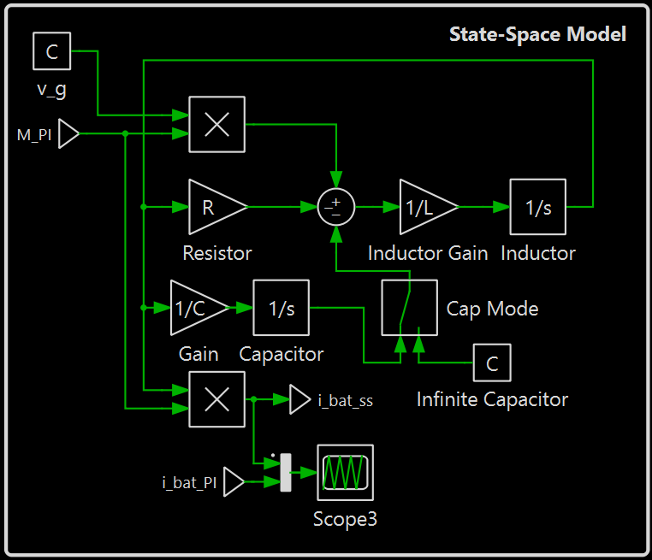

Modeling Schema – State-Space Model
Start with KCL and KVL equations for RLC branch:
$$M\left(t\right)∗V_{g}\left(t\right)−R∗i\left(t\right)−v_{c}\left(t\right)−L∗\frac{di(t)}{dt}=0$$
$$i\left(t\right)=C∗\frac{dv_{c}(t)}{dt}$$
Rearrange to solve for derivates of state variables ($i\left(t\right), v_{c}(t)$) and output $i_{bat}(t)$:
$$\frac{d}{dt}\left[\begin{matrix}i(t) \\ v_{c}(t)\end{matrix}\right]=\left[\begin{matrix}\frac{1}{L}∗\left(M\left(t\right)∗V_{g}\left(t\right)−R∗i\left(t\right)−v_{c}(t)\right) \\ \frac{1}{C}∗i\left(t\right)\end{matrix}\right]$$
$$i_{bat}=M\left(t\right)∗i\left(t\right)$$
Note the combination of state variables into a state vector – this forms the state-space model. Take integral of both sides of first equation to arrive at new mathematical model of system (bottom image)
KVL

Slide 24
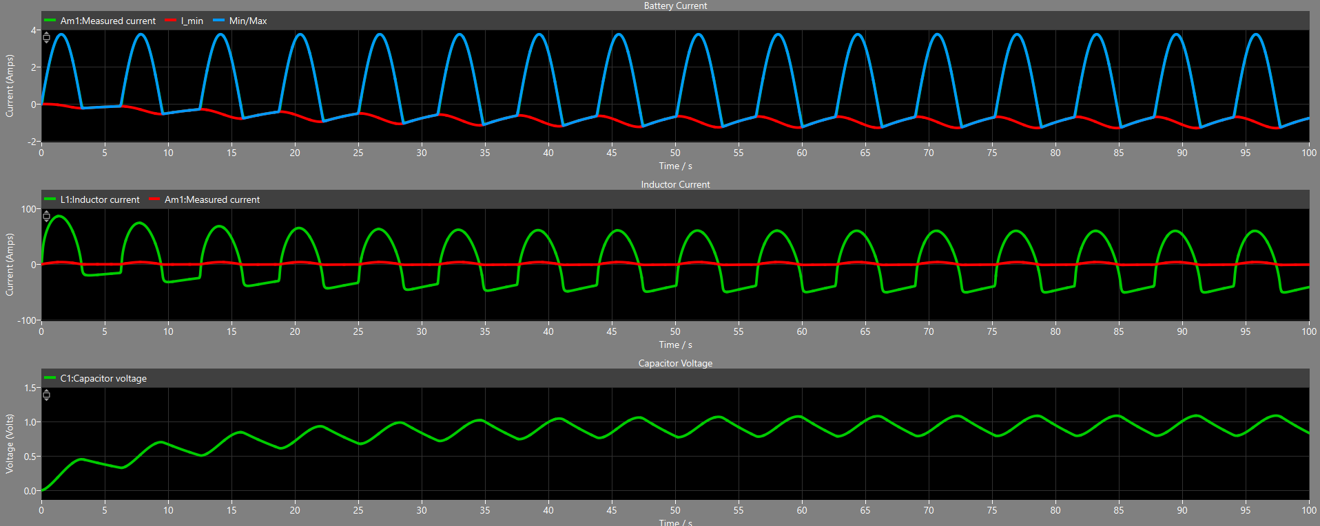
New Time-Domain Simulation (0<t<100)
With this new model, everything works!

Slide 25
Addendum: Resistance and Inductor Characteristics
3/28/2026:
4/1/2026:
First-order estimates for R approximate its value at 83 mΩ, making the maximum reverse current roughly 1.2A at full capacitor charge. Considering that the maximum reverse current scales with stored capacitor voltage and the capacitor is not expected to be at full charge during operation, this results in even lower maximum reverse current during expected operation conditions.
To ameliorate this limitation, increasing reverse current would require lower resistance across the RL branch, the lion’s share of which is from the inductor. Maximizing copper area and mitigating skin effects are of utmost importance to optimize performance.
The switched-cycle average model used to calculate maximum reverse current uses switch-cycle average voltages and currents for its modeling of system dynamics, meaning it disregards effects at the converter’s 120kHz switching frequency. Average signals can be treated as low-frequency and skin effects can be discarded.
Experimentally, the inductor was rewound to optimize DC resistance instead of AC resistance and a new resistance value of 4 mΩ was measured.

Slide 26
Section 3: Disturbance Rejection & Robustness
alright guys ill need yall to pitch in now

Slide 27


Sources of Inaccuracies: Examples
Average Inductor Current
Resistance
<i_{L}(t)>
R
Inductor current graph:
First-order calculation:
$$R_{eq}=2∗R_{on}+R_{L}+\frac{R_{C}}{4}$$
Noise on each switch transition
(+$R_{board}$)
PCB trace resistances are hard to measure
<i_{L}(t)>
i_{L}(t)
MOSFET resistance dependent on gate voltage
Inductor resistance dependent on frequency due to skin effect**
Current ripple introduces AC component
<i_{L}(t)> is not even directly measurable*
All dependent on temperature
Both signals and system parameters will not behave exactly as in the model
*It is possible to get a good guess of <i_{L}(t)> by measuring exactly between switch transitions. However, these transitions can appear arbitrarily close together due to the soft-starting capability of the H-bridge, and the AC component of the signal will introduce extra complications beyond this simplified model.
**While frequency is fixed for this application, the LCR meter in the solar lab only measures impedance at 100kHz, so it’s possible for measurement error to creep in as a result.

Slide 28
















Disturbance Rejection - Noise
Linear System With Noise
$$W(s)$$
$$R(s)$$
$$Y(s)$$
+
PI Controller
$$D(s)$$
+
Plant
$$G(s)$$
-
Linear systems can be represented by block diagrams and transfer functions
Disturbances enter at different points of the loop
Control disturbance $W(s)$, sensor noise $N(s)$, rounding error $D(s)$ all considered disturbances
Simplify feedback to single disturbance source with unity feedback
Rounding error ignored/bundled into sensor noise
Note that controller cannot tell the difference between $N\left(s\right)∗H(s)$ and $R(s)$
+
Scaling
$$H(s)$$
+
Sensor gain
$$H^{−1}(s)$$
$$D(s)$$
$$N(s)$$
Simplified UFB System
$$W(s)$$
$$R(s)$$
PI Controller
$$D(s)$$
Plant
$$G(s)$$
$$Y(s)$$
+
+
-
+
$$N\left(s\right)∗H(s)$$

Slide 29













Disturbance Rejection – Full Model
Full UFB System
$$w(t)$$
PI Controller
$$D(s)$$
Linearization
$$M_{T}(t)→M(t)$$
Plant
$$G_{iM}(t)$$
$$I_{ref}(s)$$
+
$$e(s)$$
$$M_{T}(s)$$
$$M(t)$$
+
$$I_{bat}(s)$$
-
Linearized Plant
$$G_{iM_{T}}(s)$$
$$I_{bat,sense}(s)$$
+
$$N\left(s\right)∗H(s)$$
Key Takeaway: Disturbance $w(t)$ is inserted into the nonlinear control signal $M(t)$ and cannot be analyzed using typical tools
Can trivially calculate transfer function $\frac{I_{bat}(s)}{N(s)}=H\left(s\right)∗\frac{D\left(s\right)G_{iM_{T}}(s)}{1+D\left(s\right)G_{iM_{T}}(s)}$

Slide 30


Model Robustness - Sensitivity
$$S_{G}^{T}=\frac{\frac{ΔT}{T}}{\frac{ΔG}{G}}$$
$$S_{G}^{T}=\frac{ΔT}{ΔG}∗\frac{G}{T}$$
$$S_{G}^{T}=\frac{dT}{dG}∗\frac{G}{T}$$
“Sensitivity of T to G”
Definition: Change in output behavior of a system relative to change in parameter
Relative change determined in proportion to parameter size
Can use simple calculus and algebra
Very useful metric to evaluate robustness of closed-loop control systems
Accounts for numerical stability issues like small-difference-of-large-numbers and division by small numbers
Can be done relative to the entire plant $G(s)$ or to specific parameters in the closed-loop system

Slide 31




Sensitivity
$$S_{V_{g}}^{T}=\frac{sL+R}{sL+R+DV_{g}}$$
$$S_{R}^{T}=\frac{R}{sL+R+DV_{g}}$$
$$S_{L}^{T}=\frac{sL}{sL+R+DV_{g}}$$
$$R=0.08233Ω$$
$$V_{g}=24V$$
$$L=28.306μF$$
$$K_{p}=2.13422$$
$$K_{i}=6207.54$$
$$E_{V_{g}}=\frac{R}{K_{i}V_{g}}$$
$$E_{R}=\frac{R}{K_{i}V_{g}}$$
$$E_{L}=0$$
$$E_{V_{g}}=0.55262∗{10}^{−6}$$
$$E_{R}=0.55262∗{10}^{−6}$$
$$E_{L}=0$$

Slide 32





Sensor White Noise
It was empirically found that the MSPM0-G3507 12-bit ADC’s error has SD of 14 (decimal).
$${SD_{E}}_{reading }=\frac{1}{gain_{sensor}}∗\frac{3.3}{4095}∗14$$
$$SD_{E_{i, Inductor}}=\frac{1000 A}{80 V}∗\frac{3.3 V}{4095}∗14=0.141 A$$
$$SD_{E_{i, Battery}}=\frac{1000 A}{132 V}∗\frac{3.3 V}{4095}∗14=0.0855 A$$
$$SD_{E_{v,Capacitor}}=\frac{10 V}{11 V}∗\frac{3.3V}{4095}∗14=0.0103 V$$
$$SD_{E_{v,Battery}}=\frac{8 V}{1 V}∗\frac{3.3 V}{4095}∗14=0.0903 V$$

